Slide 1
Digital Image Processing 1
Dep. of Computer Science & Information Engineering, Asia University
Associate Professor
Rung-Sheng Chen

Slide 2
Back ground
B-1. Introduction
B-2.Types of digital image processing
B-3. About the course

Slide 3
B-1. Introduction
（1） An image may be defined as a two-dimensional function, f(x,y), where x and y are spatial coordinates, and the amplitude of f at any pair of coordinates (x,y) is called the intensity or gray level of the image at that point.
（2）When x, y, and the amplitude values of f are all finite, discrete quantities, we call the image a digital image.
（3）The field of digital image processing refers to processing digital images by means of a digital computer.
（4）Note that a digital image is composed of a finite number of elements, each of which has a particular location and value. These elements are referred to as picture elements, image elements, and pixels. Pixel is the term most widely used to denote the elements of digital image.

Slide 4
（5）Vision is the most advanced of our senses, so it is not surprising that images play the signal most important role in human perception. However, unlike humans, who are limited to the visual band of the electromagnetic (EM) spectrum, imaging machines cover almost the entire EM spectrum, ranging from gamma to radio waves. They can operate also on images generated by sources that humans are not accustomed to associating with images. These include ultrasound, electron microscope, and computer-generated images. Thus, digital image processing encompasses a wide and varied field of applications.
Visible band of EM:380-760 nm

Slide 5
B-2.Types of digital image processing
.
Three types of computerized processes：
low-, mid-, and high-level processing.
（1）Low-level processes involve primitive operations such as image processing to reduce noise, contrast enhancement, and image sharpening.
A low-level process is characterized by the fact that both its inputs and
outputs are images.

Slide 6
（2）Mid-level processing on images involves tasks such as segmentation（partitioning an image into regions or objects）, description of those objects to reduce them to a form suitable for computer processing, and classification (recognition) of individual objects.
A mid-level process is characterized by the fact that its input generally are images, but its outputs are attributes extracted from those image.

Slide 7
（3）High-level processing involves “making sense” of an ensemble of recognized objects, as in image analysis, and, at the far end of the continuum, performing the cognitive functions normally associated with vision .

Slide 8
B-3. About the course
This course will provide the basic concepts and techniques of digital image processing which is the preliminary knowledge to get in to the computer vision by artificial Intelligence.

Slide 9
1. tool
2. Introduction of Image processing
3. Image processing applications
4. Digital Image Processing by Python

Slide 10
1.tool
1-1. Install Anaconda: integrate Python +
jupyter noteook
1-2. Check the Python version
1-3. Check pip
1-4. Install PIL
1-5. Install OpenCV
1-6. Install numpy

Slide 11
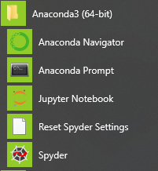
1-1 Install Anaconda
First go to the Anaconda official website , download the Anaconda version of the required operating system (Windows, macOS and Linux are optional), and then choose the 32-bit version or 64-bit version
https://www.anaconda.com/products/individual
Anaconda Prompt

Slide 12

Change directory and the folder

Slide 13
Jupyter notebook

Slide 14

1-2 Python version

Slide 15
1-3 Check pip
pip (Python Package Index)
is a software package management system written in Python computer programming language, it can install and manage software packages
After installing anaconda, pip is included

Slide 16
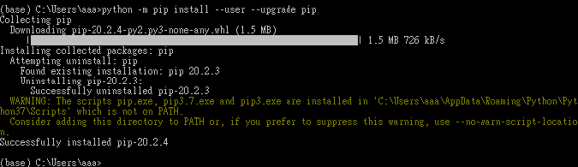
python -m pip install --user--upgrade pip

Slide 17
1-4 install pillow

Slide 18
1-5. install cv2
1.open anaconda prompt
2. python 3.7.1 install cv2
https://pypi.org/project/opencv-python/

Slide 19
1-6 install numpy

Slide 20
p.s.
You can find many helps from exploring the networks by putting corresponding key words.
Free open access, be aware the version of packages you used .

Slide 21
2. Introduction of Image processing
Before diving straight into image processing, let's understand images first. An image, as humans see it, is a two-dimensional grid (just like matrix )with each cell in the grid filled with a color value(R.G.B), otherwise called a pixel value(gray level).

Slide 22
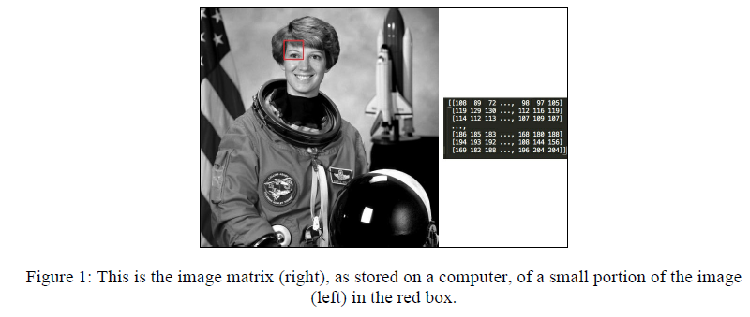
Each cell of the grid is formally called a picture element (commonly abbreviated to pixel). A computer also sees the image in the same way. An image on a computer is a two-dimensional matrix of numbers with each cell in the matrix storing the corresponding pixel value(s) in the image.
Ref:
Computer Vision with Python 3

Slide 24
Image processing is the field of studying and analyzing images. There is a lot of hidden information in an image that we unconsciously process. For example, what are the different objects in the image?, Is there a car in the image? What are the
similarities between any two images?
Answers to these questions might feel simple to us humans, but for a computer, to answer such questions is extremely difficult.
Through this lecture, it is the aim to implement some of the algorithms that can help us answer some of these questions.

Slide 25
image essence, image feature
The essence of image processing is to use the different properties of an image such as color, co-relations between different pixels, object placements, and other fine details to extract meaningful information such as edges, objects, and contours, which are formally called image features.
These features can then be used in different
applications such as medicine, security, social media services, and self-driving cars, some of which will be discussed in the following lectures.

Slide 26
3. Image processing applications
For example
Medicine:
In recent years, the field of medicine has seen rapid advancements.
For example, more sophisticated imaging techniques and better techniques to detect the nature of tumors in MRI/PET scans. The interdisciplinary research
between biology and image processing played an important role.
The following image illustrates how image processing algorithms are being used to detect tumors. This has helped in early diagnosis of diseases and a more effective treatment:

Slide 27
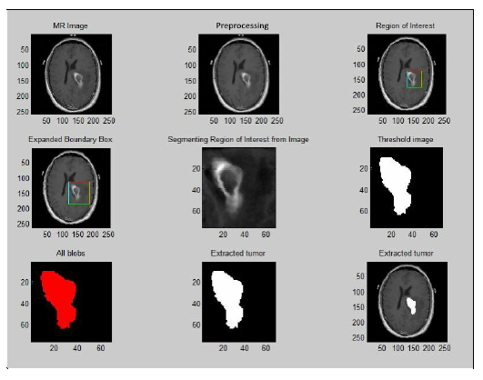
Figure 2 : The image shows how image processing can be used to detect tumors.

Slide 28
4. Digital Image Processing by Python
4-1 Python Image Library
4-2 scikit-image
4-3 cv2 installation

Slide 29
4-1 Python Image Library
Pillow is an open source library that has been forked from the Python Imaging Library (PIL). Pillow is a very good starting point for beginners who want to start with implementing some basic algorithms before diving into the more complex ones.

Slide 30
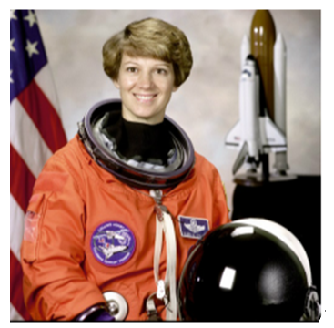
4-1-1 Reading an image
from PIL import Image
img = Image.open("F:/Computer Vision/newastronaut.png") % if the image file is not at the directory you use
Or
Img=Image.open(“newastronaut.png”)% if the image file is at the directiry you use
img.show()

Slide 31
4-1-2 Writing or saving an image
To write or save an image to a file on your computer, use the save() function
associated to the image object.
img.save("F:/Computer Vision/astronaut2.png")

Slide 32
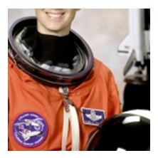
4-1-3 Cropping an image
Cropping an image means to extract a particular region of the image, which is
smaller than the original image. This region in some books/references in called the Region of Interest (ROI). The concept of ROI is sometimes useful when you want to run your algorithm only on a particular part of the image and not the entire image.
The image object has a crop() function that takes two coordinates--the upper-left corner and the bottom-right corner of the rectangle that you are interested in—and returns the cropped image:
dim = (100,100,300,300) # Dimensions of the ROI
crop_img = img.crop(dim) #影像切割
crop_img.show() # 顯示影像切割

Slide 33
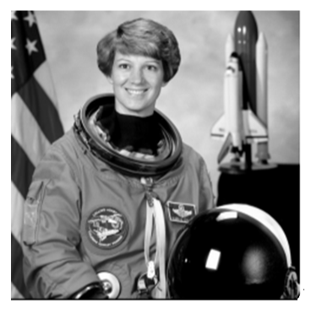
4-1-4 Changing between color spaces
Grayscale: This is one of the simplest color spaces both in terms of
understanding and storing on a computer. Each pixel value in a grayscale image
is a single value between 0 and 255, with 0 representing black and 255
representing white.
greyscale = img.convert(“L”) # 彩色轉灰階
greyscale.show()

Slide 34
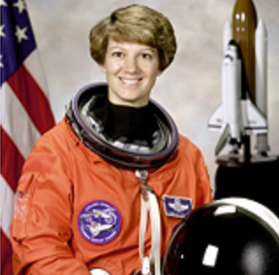
Accessing pixels of an image
Sometimes for performing tasks such as thresholding (which will be covered later in
the book), we have to access the individual pixels in an image. Pillow provides a
PixelAccess class with functions to manipulate image pixel values. getpixel()
img = Image.open("F:/Computer Vision/newastronaut.png")
print (img.size)
(512, 512)
img.getpixel((355,443))
(254, 254, 254)
(254, 254, 254)

Slide 35
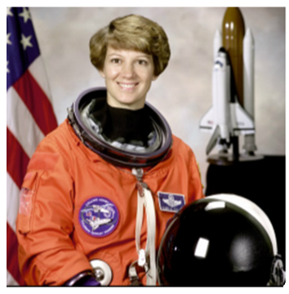
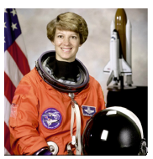
4-1-5 Geometrical transformation
There are times when you need to perform different types of transformations to
images such as resize, rotate, and flip. Pillow provides direct functions to perform
these transformations,
Resize: To resize an image, use the resize() function
print (img.size) # check the image size
(512, 512)
resize_img = img.resize((256,256))
resize_img.show()

Slide 36
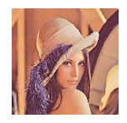
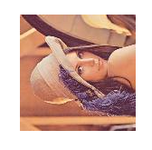
4-1-6 Rotate: To rotate an image, use the rotate() function, which takes in the
degrees to be rotated (counter clockwise) as an argument:
rotate_img = img.rotate(90)
from PIL import Image
img = Image.open("F:/Computer Vision/lena.png")
img.show()
rotate_img=img.rotate(90)
Rotate_img.show()

Slide 37
Ref:
Saurabh Kapur, “Computer Vision with Python”, Packt Publishing Ltd. Birmingham, U.K., 2017

